Slide 1
CPR E 281: Digital Logic
Md Maruf Ahamed
Office: 307 Durham Center
Phone: (515) 294-6323
Email: maruf@iastate.edu

Slide 2
Administrative Stuff
  Homework: HW#10 due on Sunday @ 11:59 PM
  Quiz: Quiz #12 due on Friday @ 4:25 PM
  Recitation: Recitation 11 this week
  Lab: Lab 11 this week
  Lecture-34 Readings: 6.10 – 6.13
  Final Exam: Thursday, May 12th, 2:15PM–4:15 PM

Slide 3
34-ASM Charts and Examples
  Algorithmic State Machine (ASM) Charts
  FSM design examples

Slide 4
RodRego
Reading Material for Next Lecture
“The Seven Secrets of Computer Power Revealed” by Daniel Dennett.
This is Chapter 24 in his book “Intuition Pumps and Other Tools for Thinking”, 2013
You can download a register machine emulator from:
http://sites.tufts.edu/rodrego/
It works on both Macs and PCs. It’s pretty cool.
This web link is also in the book chapter.
There is also a version that works in a browser:
http://proto.atech.tufts.edu/RodRego/

Slide 5
ASM charts & Examples
Readings 6.10 – 6.13

Slide 6
ASM Charts: Motivation
The state diagrams and tables used in chapter 6 are convenient for describing the behavior of FSMs that have only a few inputs and outputs.
For larger machines the designers often use a different form of representation, called the algorithmic state machine (ASM) chart.
An ASM chart is a type of flowchart that can be used to represent the state transitions and generated outputs for an FSM.

Slide 7
Three Elements used in ASM charts
State name
Output signals
0 (False)
Condition
1 (True)
or actions
expression
(Moore type)
(a) State box
(b) Decision box
Conditional outputs
or actions (Mealy type)
(c) Conditional output box
[ Figure 6.81 from the textbook ]

Slide 8
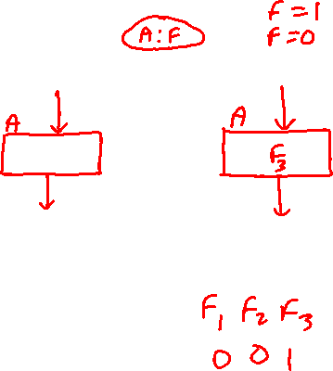
State Box
State name
Output signals
or actions
(Moore type)
Indicated with a rectangle
Equivalent to a node in the State diagram
The name of the state is written outside the box
Moore-type outputs are written inside the box
Only the output that must be set to 1 is written (by default, if an output is not listed it is set to 0)

Slide 9
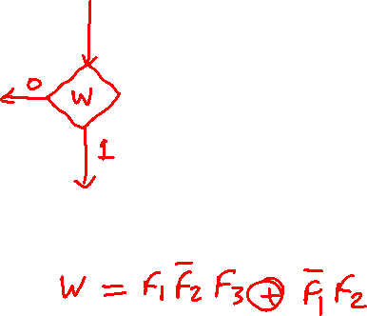
Decision Box
0 (False)
Condition
1 (True)
expression
Indicated with a diamond shape
Used for a condition expression that must be tested
The exit path is chosen based on the outcome of the test
The condition is on one or more inputs to the FSM
Shortcut notation: w means “is w equal to 1?”

Slide 10
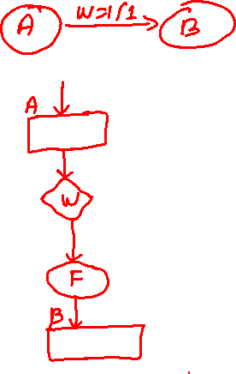
Conditional Output Box
Conditional outputs
or actions (Mealy type)
Indicated with an oval shape
Used for a Mealy-type output signals
The outputs depend on the state variables and inputs
The condition that determines when such outputs are generated is placed in a separate decision box
[ Figure 6.81c from the textbook ]

Slide 11
Some Examples

Slide 12
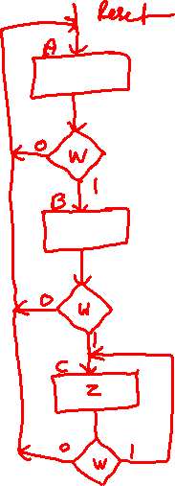
FSM ASM chart
Reset
w
=
1
w
=
0
A
⁄
z
=
0
B
⁄
z
=
0
w
=
0
w
=
0
w
=
1
C
⁄
z
=
1
w
=
1
Moore Machine
[ Figure 6.3 from the textbook ]
[ Figure 6.82 from the textbook ]

Slide 13
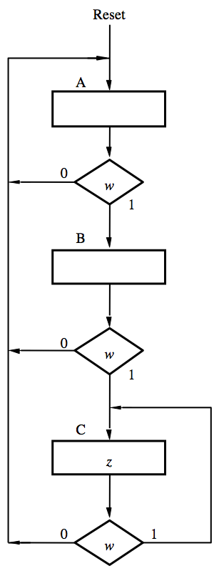
FSM ASM chart
Reset
w
=
1
w
=
0
A
⁄
z
=
0
B
⁄
z
=
0
w
=
0
w
=
0
w
=
1
C
⁄
z
=
1
w
=
1
Moore Machine
[ Figure 6.3 from the textbook ]
[ Figure 6.82 from the textbook ]

Slide 14
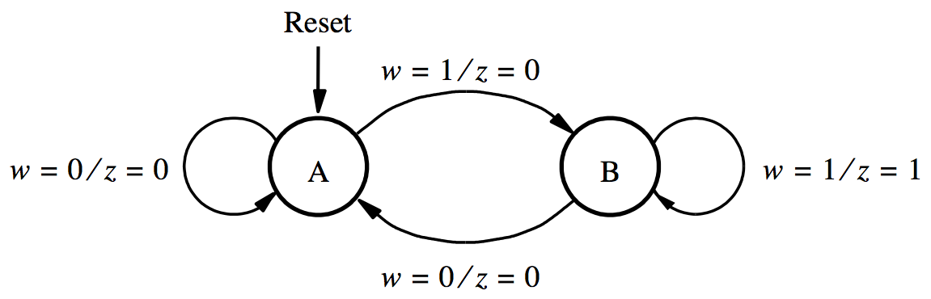
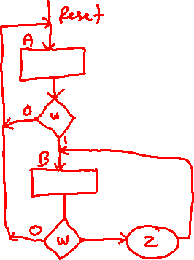
FSM ASM chart
Mealy Machine
[ Figure 6.23 from the textbook ]
[ Figure 6.83 from the textbook ]

Slide 15
FSM ASM chart
[ Figure 6.23 from the textbook ]
Mealy Machine
[ Figure 6.83 from the textbook ]

Slide 16
ASM Chart is different from a Flow Chart
The ASM chart implicitly includes timing info.
It is assumed that the underlying FSM changes from one state to another on every active clock edge
Flow charts don’t make that assumption.

Slide 17
(i) Moore Type
W
Combinational
Q(t+1)
Q(t)
Combinational
Flip-flops
circuit
Z
circuit
Q
Clock
(ii) Mealy Type
W
Combinational
Q(t+1)
Q(t)
Combinational
Flip-flops
circuit
Z
circuit
Q
Clock

Slide 18
The general model for a sequential circuit
w
z
1
1
Inputs
Outputs
w
Combinational
z
n
m
circuit
y
Y
k
k
Present-state
Next-state
variables
variables
y
Y
1
1
[ Figure 6.85 from the textbook ]

Slide 19
Examples of Solved Problems

Slide 20
Example 6.12

Slide 21
Goal
Design an FSM that detects if the previous two values of the input w were equal to 00 or 11.
If either condition is true then the output z should be set to 1; otherwise to 0.

Slide 22
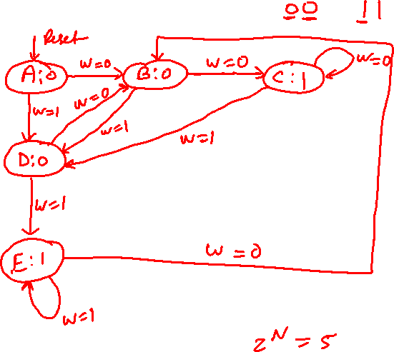
State Diagram
Design an FSM that detects if the previous two values of the input w were equal to 00 or 11.
[ Figure 6.86 from the textbook ]

Slide 23
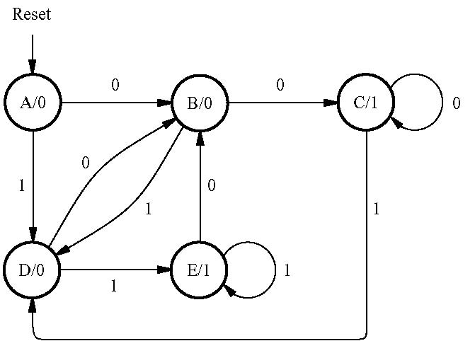
State Diagram
Design an FSM that detects if the previous two values of the input w were equal to 00 or 11.
[ Figure 6.86 from the textbook ]

Slide 24
State Table for the FSM
[ Figure 6.86 from the textbook ]
[ Figure 6.87 from the textbook ]

Slide 25
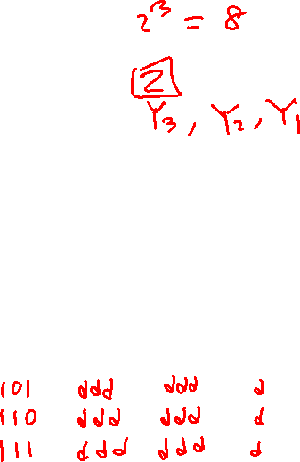
State-Assigned Table for the FSM
[ Figure 6.88 from the textbook ]

Slide 26

State-Assigned Table for the FSM
How can we derive this expression?

Slide 27
State-Assigned Table for the FSM
101
110
111
ddd
ddd
ddd
ddd
ddd
ddd
d
d
d

Slide 28
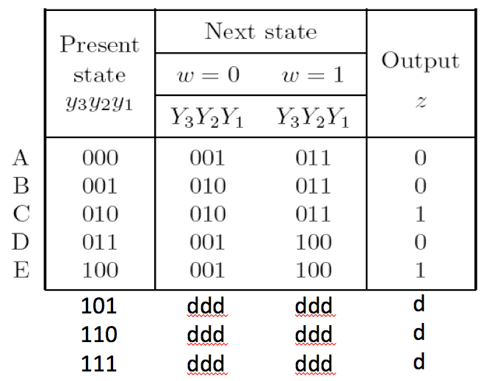
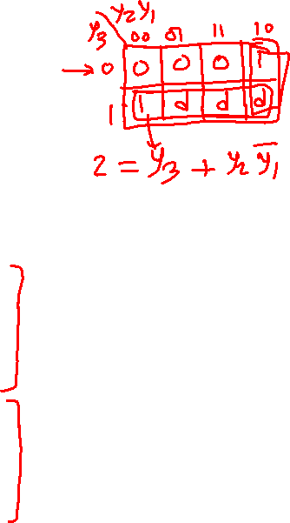
Truth Table for the Output z
y₃ | y₂ | y₁ | z
0 | 0 | 0
0 | 0 | 1
0 | 1 | 0
0 | 1 | 1
1 | 0 | 0
1 | 0 | 1
1 | 1 | 0
1 | 1 | 1

Slide 29
Truth Table for the Output z
y₃ | y₂ | y₁ | z
0 | 0 | 0 | 0
0 | 0 | 1 | 0
0 | 1 | 0 | 1
0 | 1 | 1 | 0
1 | 0 | 0 | 1
1 | 0 | 1 | d
1 | 1 | 0 | d
1 | 1 | 1 | d

Slide 30
Truth Table for the Output z
y₃ | y₂ | y₁ | z
0 | 0 | 0 | 0
0 | 0 | 1 | 0
0 | 1 | 0 | 1
0 | 1 | 1 | 0
1 | 0 | 0 | 1
1 | 0 | 1 | d
1 | 1 | 0 | d
1 | 1 | 1 | d

Slide 31
K-Map for the Output z
z
y
y
3
2
y₁
00
01
11
10
0
0 1 d 1
0 0 d d
1
y₃ | y₂ | y₁ | z
0 | 0 | 0 | 0
0 | 0 | 1 | 0
0 | 1 | 0 | 1
0 | 1 | 1 | 0
1 | 0 | 0 | 1
1 | 0 | 1 | d
1 | 1 | 0 | d
1 | 1 | 1 | d

Slide 32
The Expression for the Output z
z
y
y
y₁ y₂
y₃
3
2
y₁
00
01
11
10
0
0 1 d 1
0 0 d d
1
y₃ | y₂ | y₁ | z
0 | 0 | 0 | 0
0 | 0 | 1 | 0
0 | 1 | 0 | 1
0 | 1 | 1 | 0
1 | 0 | 0 | 1
1 | 0 | 1 | d
1 | 1 | 0 | d
1 | 1 | 1 | d

Slide 33
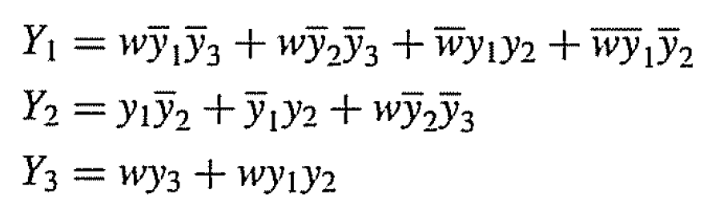
State-Assigned Table for the FSM
How can we derive these expressions?

Slide 34
Truth Table for Y₃
w | y₃ | y₂ | y₁ | Y₃ | Y₂ | Y₁
0 | 0 | 0 | 0 | 0
0 | 0 | 0 | 1 | 0
0 | 0 | 1 | 0 | 0
0 | 0 | 1 | 1 | 0
0 | 1 | 0 | 0 | 0
0 | 1 | 0 | 1 | d
0 | 1 | 1 | 0 | d
0 | 1 | 1 | 1 | d
1 | 0 | 0 | 0 | 0
1 | 0 | 0 | 1 | 0
1 | 0 | 1 | 0 | 0
1 | 0 | 1 | 1 | 1
1 | 1 | 0 | 0 | 1
1 | 1 | 0 | 1 | d
1 | 1 | 1 | 0 | d
1 | 1 | 1 | 1 | d

Slide 35
Truth Table for Y₂
w | y₃ | y₂ | y₁ | Y₃ | Y₂ | Y₁
0 | 0 | 0 | 0 | 0 | 0
0 | 0 | 0 | 1 | 0 | 1
0 | 0 | 1 | 0 | 0 | 1
0 | 0 | 1 | 1 | 0 | 0
0 | 1 | 0 | 0 | 0 | 0
0 | 1 | 0 | 1 | d | d
0 | 1 | 1 | 0 | d | d
0 | 1 | 1 | 1 | d | d
1 | 0 | 0 | 0 | 0 | 1
1 | 0 | 0 | 1 | 0 | 1
1 | 0 | 1 | 0 | 0 | 1
1 | 0 | 1 | 1 | 1 | 0
1 | 1 | 0 | 0 | 1 | 0
1 | 1 | 0 | 1 | d | d
1 | 1 | 1 | 0 | d | d
1 | 1 | 1 | 1 | d | d

Slide 36
Truth Table for Y₁
w | y₃ | y₂ | y₁ | Y₃ | Y₂ | Y₁
0 | 0 | 0 | 0 | 0 | 0 | 1
0 | 0 | 0 | 1 | 0 | 1 | 0
0 | 0 | 1 | 0 | 0 | 1 | 0
0 | 0 | 1 | 1 | 0 | 0 | 1
0 | 1 | 0 | 0 | 0 | 0 | 1
0 | 1 | 0 | 1 | d | d | d
0 | 1 | 1 | 0 | d | d | d
0 | 1 | 1 | 1 | d | d | d
1 | 0 | 0 | 0 | 0 | 1 | 1
1 | 0 | 0 | 1 | 0 | 1 | 1
1 | 0 | 1 | 0 | 0 | 1 | 1
1 | 0 | 1 | 1 | 1 | 0 | 0
1 | 1 | 0 | 0 | 1 | 0 | 0
1 | 1 | 0 | 1 | d | d | d
1 | 1 | 1 | 0 | d | d | d
1 | 1 | 1 | 1 | d | d | d

Slide 37
K-Maps for Y₃, Y₂, Y₁
w | y₃ | y₂ | y₁ | Y₃ | Y₂ | Y₁
0 | 0 | 0 | 0 | 0 | 0 | 1
0 | 0 | 0 | 1 | 0 | 1 | 0
0 | 0 | 1 | 0 | 0 | 1 | 0
0 | 0 | 1 | 1 | 0 | 0 | 1
0 | 1 | 0 | 0 | 0 | 0 | 1
0 | 1 | 0 | 1 | d | d | d
0 | 1 | 1 | 0 | d | d | d
0 | 1 | 1 | 1 | d | d | d
1 | 0 | 0 | 0 | 0 | 1 | 1
1 | 0 | 0 | 1 | 0 | 1 | 1
1 | 0 | 1 | 0 | 0 | 1 | 1
1 | 0 | 1 | 1 | 1 | 0 | 0
1 | 1 | 0 | 0 | 1 | 0 | 0
1 | 1 | 0 | 1 | d | d | d
1 | 1 | 1 | 0 | d | d | d
1 | 1 | 1 | 1 | d | d | d
Y₃
w y₃
y₂ y₁
00
01
11
10
00
0
0
1
0
01
0
d
d
0
11
0
d
d
1
Y₂
w y₃
10
0
d
d
0
y₂ y₁
00
01
11
10
00
0
0
0
1
01
1
d
d
1
Y₁
11
0
d
d
0
w y₃
y₂ y₁
00
01
11
10
10
1
d
d
1
00
1
1
0
1
01
0
d
d
1
11
1
d
d
0
10
0
d
d
1

Slide 38
Expressions for Y₃, Y₂, Y₁
w | y₃ | y₂ | y₁ | Y₃ | Y₂ | Y₁
0 | 0 | 0 | 0 | 0 | 0 | 1
0 | 0 | 0 | 1 | 0 | 1 | 0
0 | 0 | 1 | 0 | 0 | 1 | 0
0 | 0 | 1 | 1 | 0 | 0 | 1
0 | 1 | 0 | 0 | 0 | 0 | 1
0 | 1 | 0 | 1 | d | d | d
0 | 1 | 1 | 0 | d | d | d
0 | 1 | 1 | 1 | d | d | d
1 | 0 | 0 | 0 | 0 | 1 | 1
1 | 0 | 0 | 1 | 0 | 1 | 1
1 | 0 | 1 | 0 | 0 | 1 | 1
1 | 0 | 1 | 1 | 1 | 0 | 0
1 | 1 | 0 | 0 | 1 | 0 | 0
1 | 1 | 0 | 1 | d | d | d
1 | 1 | 1 | 0 | d | d | d
1 | 1 | 1 | 1 | d | d | d
Y₃
Y₂
w y₃
w y₃
y₂ y₁
y₂ y₁
00
01
11
10
00
01
11
10
00
0
0
1
0
00
0
0
0
1
01
0
d
d
0
01
1
d
d
1
11
0
d
d
1
11
0
d
d
0
10
0
d
d
0
10
1
d
d
1
Y₁
w y₃
y₂ y₁
00
01
11
10
00
1
1
0
1
01
0
d
d
1
11
1
d
d
0
10
0
d
d
1

Slide 39
Next State and Output Expressions

Slide 40

An Improved State-Assigned Table
B,C, D, E – when y₃=1
[ Figure 6.87 from the textbook ]
[ Figure 6.89 from the textbook ]

Slide 41
An Improved State-Assigned Table
[ Figure 6.89 from the textbook ]

Slide 42
An Improved State-Assigned Table
cut here

Slide 43
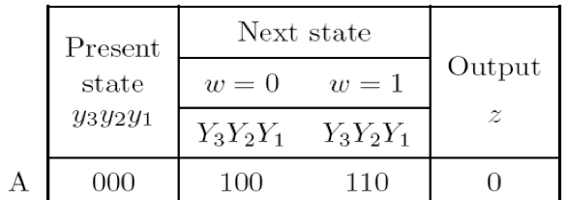
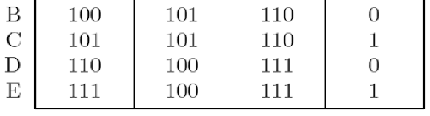
An Improved State-Assigned Table
001
010
011
ddd
ddd
ddd
ddd
ddd
ddd
d
d
d

Slide 44
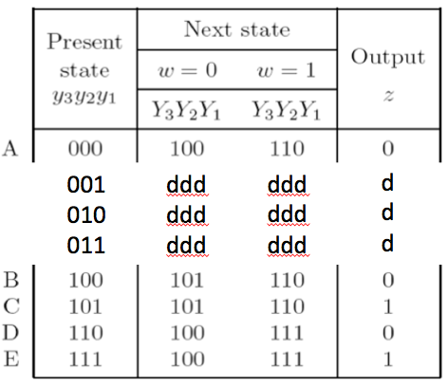
Truth Table for the Output z
y₃ | y₂ | y₁ | z
0 | 0 | 0 | 0
0 | 0 | 1 | d
0 | 1 | 0 | d
0 | 1 | 1 | d
1 | 0 | 0 | 0
1 | 0 | 1 | 1
1 | 1 | 0 | 0
1 | 1 | 1 | 1

Slide 45
Expression for the Output z
z
y
y
y₁
3
2
y₁
00
01
11
10
0
0 d 0 0
d d 1 1
1
y₃ | y₂ | y₁ | z
0 | 0 | 0 | 0
0 | 0 | 1 | d
0 | 1 | 0 | d
0 | 1 | 1 | d
1 | 0 | 0 | 0
1 | 0 | 1 | 1
1 | 1 | 0 | 0
1 | 1 | 1 | 1

Slide 46
Truth Table for Y₃
w | y₃ | y₂ | y₁ | Y₃ | Y₂ | Y₁
0 | 0 | 0 | 0 | 1
0 | 0 | 0 | 1 | d
0 | 0 | 1 | 0 | d
0 | 0 | 1 | 1 | d
0 | 1 | 0 | 0 | 1
0 | 1 | 0 | 1 | 1
0 | 1 | 1 | 0 | 1
0 | 1 | 1 | 1 | 1
1 | 0 | 0 | 0 | 1
1 | 0 | 0 | 1 | d
1 | 0 | 1 | 0 | d
1 | 0 | 1 | 1 | d
1 | 1 | 0 | 0 | 1
1 | 1 | 0 | 1 | 1
1 | 1 | 1 | 0 | 1
1 | 1 | 1 | 1 | 1

Slide 47
Truth Table for Y₂
w | y₃ | y₂ | y₁ | Y₃ | Y₂ | Y₁
0 | 0 | 0 | 0 | 1 | 0
0 | 0 | 0 | 1 | d | d
0 | 0 | 1 | 0 | d | d
0 | 0 | 1 | 1 | d | d
0 | 1 | 0 | 0 | 1 | 0
0 | 1 | 0 | 1 | 1 | 0
0 | 1 | 1 | 0 | 1 | 0
0 | 1 | 1 | 1 | 1 | 0
1 | 0 | 0 | 0 | 1 | 1
1 | 0 | 0 | 1 | d | d
1 | 0 | 1 | 0 | d | d
1 | 0 | 1 | 1 | d | d
1 | 1 | 0 | 0 | 1 | 1
1 | 1 | 0 | 1 | 1 | 1
1 | 1 | 1 | 0 | 1 | 1
1 | 1 | 1 | 1 | 1 | 1

Slide 48
Truth Table for Y₁
w | y₃ | y₂ | y₁ | Y₃ | Y₂ | Y₁
0 | 0 | 0 | 0 | 1 | 0 | 0
0 | 0 | 0 | 1 | d | d | d
0 | 0 | 1 | 0 | d | d | d
0 | 0 | 1 | 1 | d | d | d
0 | 1 | 0 | 0 | 1 | 0 | 1
0 | 1 | 0 | 1 | 1 | 0 | 1
0 | 1 | 1 | 0 | 1 | 0 | 0
0 | 1 | 1 | 1 | 1 | 0 | 0
1 | 0 | 0 | 0 | 1 | 1 | 0
1 | 0 | 0 | 1 | d | d | d
1 | 0 | 1 | 0 | d | d | d
1 | 0 | 1 | 1 | d | d | d
1 | 1 | 0 | 0 | 1 | 1 | 0
1 | 1 | 0 | 1 | 1 | 1 | 0
1 | 1 | 1 | 0 | 1 | 1 | 1
1 | 1 | 1 | 1 | 1 | 1 | 1

Slide 49
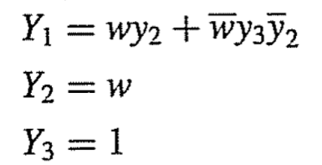
K-Maps for Y₃, Y₂, Y₁
w | y₃ | y₂ | y₁ | Y₃ | Y₂ | Y₁
0 | 0 | 0 | 0 | 1 | 0 | 0
0 | 0 | 0 | 1 | d | d | d
0 | 0 | 1 | 0 | d | d | d
0 | 0 | 1 | 1 | d | d | d
0 | 1 | 0 | 0 | 1 | 0 | 1
0 | 1 | 0 | 1 | 1 | 0 | 1
0 | 1 | 1 | 0 | 1 | 0 | 0
0 | 1 | 1 | 1 | 1 | 0 | 0
1 | 0 | 0 | 0 | 1 | 1 | 0
1 | 0 | 0 | 1 | d | d | d
1 | 0 | 1 | 0 | d | d | d
1 | 0 | 1 | 1 | d | d | d
1 | 1 | 0 | 0 | 1 | 1 | 0
1 | 1 | 0 | 1 | 1 | 1 | 0
1 | 1 | 1 | 0 | 1 | 1 | 1
1 | 1 | 1 | 1 | 1 | 1 | 1
Y₃
w y₃
y₂ y₁
00
01
11
10
00
1
1
1
1
01
d
1
1
d
11
d
1
1
d
Y₂
w y₃
10
d
1
1
d
y₂ y₁
00
01
11
10
00
0
0
1
1
01
d
0
1
d
Y₁
11
d
0
1
d
w y₃
y₂ y₁
00
01
11
10
10
d
0
1
d
00
0
1
0
0
01
d
1
0
d
11
d
0
1
d
10
d
0
1
d

Slide 50
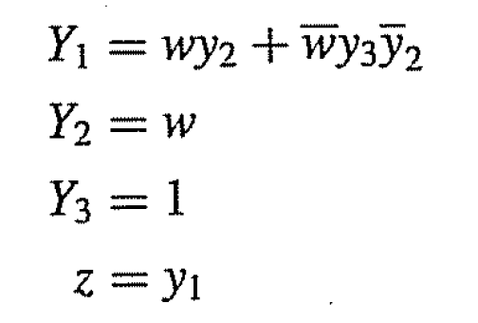

An Improved State-Assigned Table

Slide 51
An Improved State-Assigned Table

Slide 52
An Improved State-Assigned Table

Slide 53
Example 6.13

Slide 54
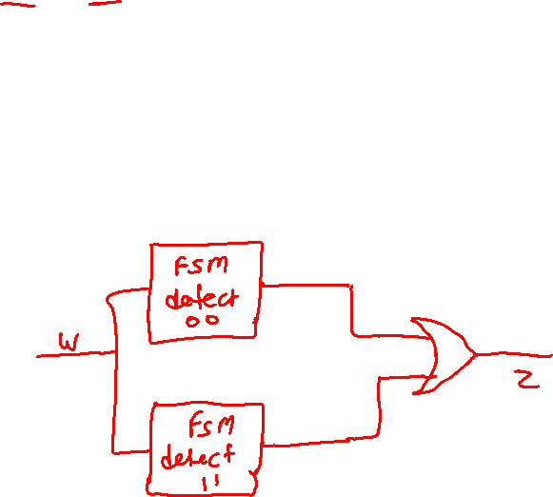
Goal
Design an FSM that detects if the previous two values of the input w were equal to 00 or 11.
But do this with two different FSMs. The first one detects two consecutive 1's. The second one detects two consecutive 0's.
If either condition (i.e., output of FSM) is true then the output z should be set to 1; otherwise to 0.

Slide 55
The Two FSMs
Reset
Reset
w
=
1
w
=
0
w
=
0
A: z = 0
B: z = 0
w
=
1
D: z = 0
E: z = 0
w
=
0
w
=
1
w
=
0
w
=
1
w
=
1
w
=
0
C: z = 1
F: z = 1
w
=
1
w
=
0
Detect two consecutive 1's
Detect two consecutive 0's

Slide 56
Example 6.13
(Construct the first FSM)

Slide 57
FSM to detect two consecutive 1's
(this was the first example in Chapter 6)
Reset
w
=
1
w
=
0
A: z = 0
B: z = 0
w
=
0
w
=
0
w
=
1
C: z = 1
w
=
1
[ Figure 6.3 from the textbook ]

Slide 58
Reset
w
=
1
w
=
0
A: z = 0
B: z = 0
w
=
0
w
=
0
w
=
1
C: z = 1
w
=
1
Present
Next state
Output
state
w
=
0
w
=
1
z
A
A
B
0
B
A
C
0
C
A
C
1
[ Figure 6.4 from the textbook ]

Slide 59
A Better State Encoding
Present
Next state
Output
state
w
=
0
w
=
1
z
A
A
B
0
B
A
C
0
C
A
C
1
Suppose we encoded our states another way:
A ~ 00
B ~ 01
C ~ 11

Slide 60
A Better State Encoding
Present
Next state
Output
state
w
=
0
w
=
1
z
A
A
B
0
B
A
C
0
C
A
C
1
Next state
Present
state
w
=
0
w
=
1
Output
A ~ 00
B ~ 01
C ~ 11
z
y
2
y
1
Y
2
Y
1
Y
2
Y
1
A
00
00
01
0
B
01
00
11
0
C
11
00
11
1
10
dd
dd
d

Slide 61
Let's Derive the Logic Expressions
Next state
Present
state
w
=
0
w
=
1
Output
Warning:
This table does not enumerate y₂y₁, in the standard way, so be careful when filling out the K-Map.
z
y
2
y
1
Y
2
Y
1
Y
2
Y
1
A
00
00
01
0
B
01
00
11
0
C
11
00
11
1
10
dd
dd
d
Y₂
Y₁
z
y
2
y
1
y
2
y
1
y
1
w
y
2
0
1
00
01
11
10
w
00
01
11
10
0
0
0
1
1
1

Slide 62
Let's Derive the Logic Expressions
Next state
Present
state
w
=
0
w
=
1
Output
Warning:
This table does not enumerate y₂y₁, in the standard way, so be careful when filling out the K-Map.
z
y
2
y
1
Y
2
Y
1
Y
2
Y
1
A
00
00
01
0
B
01
00
11
0
C
11
00
11
1
10
dd
dd
d
Y₂
Y₁
z
y
2
y
1
y
2
y
1
y
1
w
y
2
0
1
00
01
11
10
w
00
01
11
10
0
0
0
0
d
0
0
0
0
d
0
0
0
1
0
1
1
d
1
1
1
1
d
1
d
1
Y₂(w, y₂, y₁) = wy₁
Y₁(w, y₂, y₁) = w
z(y₂, y₁) = y₂

Slide 63
The Circuit Diagram
Y
y
Y₁(w, y₂, y₁) = w
2
2
z
D
Q
Y₂(w, y₂, y₁) = wy₁
Q
z(y₂, y₁) = y₂
Y
y
w
1
1
D
Q
Clock
Q
Resetn
[ Figure 6.17 from the textbook ]

Slide 64
Example 6.13
(Construct the second FSM)

Slide 65
FSM to detect two consecutive 0's
Reset
w
=
0
w
=
1
D: z = 0
E: z = 0
w
=
1
w
=
1
w
=
0
F: z = 1
w
=
0
This is similar to the previous one. Just invert the w's and relabel the states to D,E,F.

Slide 66
Reset
w
=
0
w
=
1
D: z = 0
E: z = 0
w
=
1
w
=
1
w
=
0
F: z = 1
w
=
0
Present
Next state
Output
state
w
=
0
w
=
1
z
D
E
D
0
E
F
D
0
F
F
D
1

Slide 67
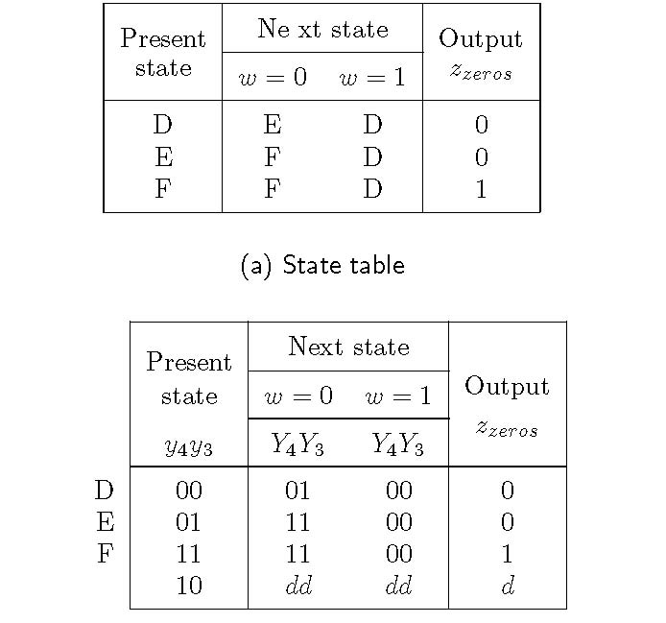
FSM that detects a sequence of two zeros
[ Figure 6.90 from the textbook ]

Slide 68
FSM that detects a sequence of two zeros
Only these two columns
are swapped relative to
the first FSM. And the
states have different
names now.
Only these two columns
are swapped relative to
the first FSM.
[ Figure 6.90 from the textbook ]

Slide 69
Let's Derive the Logic Expressions
Next state
Present
state
w
=
0
w
=
1
Output
z
y
4
y
3
Y
4
Y
3
Y
4
Y
3
D
00
01
00
0
E
01
11
00
0
F
11
11
00
1
10
dd
dd
d
Y₄
Y₃
z
y
4
y
3
y
4
y
3
y
4
w
y
3
0
1
00
01
11
10
w
00
01
11
10
0
0
0
1
1
1

Slide 70
Let's Derive the Logic Expressions
Next state
Present
state
w
=
0
w
=
1
Output
z
y
4
y
3
Y
4
Y
3
Y
4
Y
3
D
00
01
00
0
E
01
11
00
0
F
11
11
00
1
10
dd
dd
d
Y₄
Y₃
z
y
4
y
3
y
4
y
3
y
3
w
y
4
0
1
00
01
11
10
w
00
01
11
10
0
0
1
1
d
0
1
1
1
d
0
0
0
1
0
0
0
d
1
0
0
0
d
1
d
1
Y₄(w, y₄ , y₃ ) = w y₃
Y₃(w, y₄ , y₃ ) = w
z(y₄ , y₃ ) = y₄

Slide 71
The Circuit Diagram
Y
y
Y₃(w, y₄ , y₃ ) = w
4
4
z
D
Q
Y₄(w, y₄ , y₃ ) = w y₃
Q
z(y₂, y₁ ) = y₄
Y
y
w
3
3
D
Q
Clock
Q
Resetn

Slide 72
Example 6.13
(Combine the two FSMs)

Slide 73
The Two FSMs
Reset
Reset
w
=
1
w
=
0
w
=
0
A: z = 0
B: z = 0
w
=
1
D: z = 0
E: z = 0
w
=
0
w
=
1
w
=
0
w
=
1
w
=
1
w
=
0
C: z = 1
F: z = 1
w
=
1
w
=
0
Detect two consecutive 1's
Detect two consecutive 0's

Slide 74
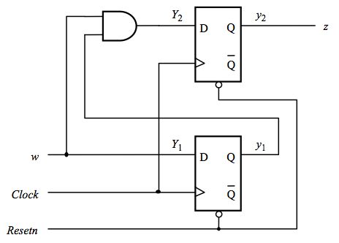
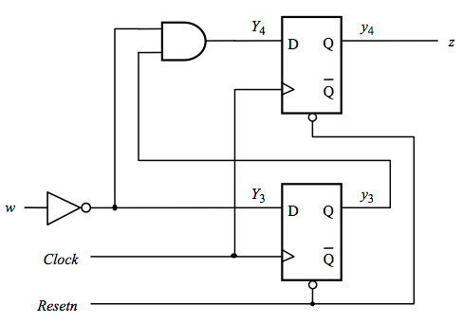
The Two Circuit Diagrams
Detect two consecutive 1's
Detect two consecutive 0's

Slide 75
The Combined Circuit Diagram
Detect two consecutive 1's or two consecutive 0's

Slide 76
Example 6.14

Slide 77
Goal
Design an FSM that detects if the previous two values of the input w were equal to 00 or 11.
If either condition is true then the output z should be set to 1; otherwise to 0.
Implement this as a Mealy-type machine

Slide 78
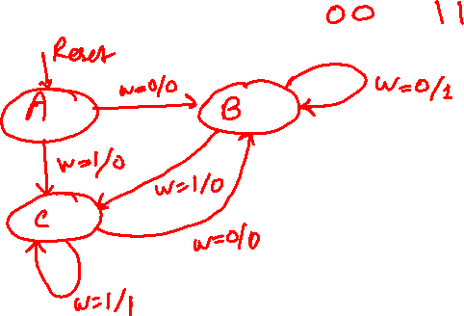
State Diagram
Design an FSM that detects if the previous two values of the input w were equal to 00 or 11.
[ Figure 6.91 from the textbook ]

Slide 79
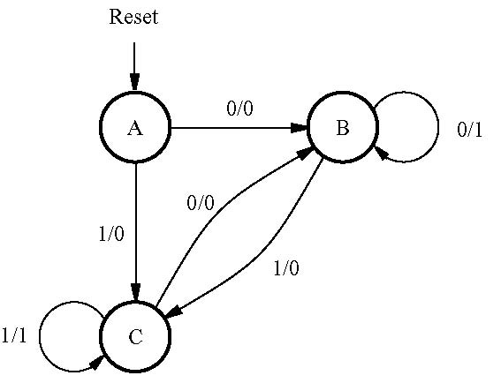
State Diagram
Design an FSM that detects if the previous two values of the input w were equal to 00 or 11.
[ Figure 6.91 from the textbook ]

Slide 80
Building the State Table
[ Figure 6.92 from the textbook ]

Slide 81
Building the State-Assigned Table
[ Figure 6.93 from the textbook ]

Slide 82
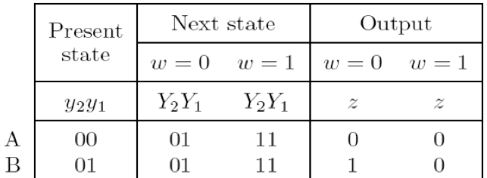
State-Assigned Table
[ Figure 6.93 from the textbook ]

Slide 83
State-Assigned Table
cut here

Slide 84
State-Assigned Table

Slide 85
State-Assigned Table
1 0
d d
d d
d
d

Slide 86
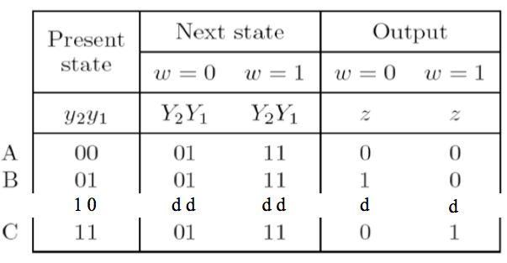
Truth Table for Y₂, Y₁, and z
w | y₂ | y₁ | Y₂ | Y₁ | z
0 | 0 | 0 | 0 | 1 | 0
0 | 0 | 1 | 0 | 1 | 1
0 | 1 | 0 | d | d | d
0 | 1 | 1 | 0 | 1 | 0
1 | 0 | 0 | 1 | 1 | 0
1 | 0 | 1 | 1 | 1 | 0
1 | 1 | 0 | d | 1 | d
1 | 1 | 1 | 1 | 1 | 1

Slide 87
K-Maps for Y₂, Y₁, and z
Y₂
w
y
2
y₁
00
01
11
10
0 d d 1
0 0 1 1
w | y₂ | y₁ | Y₂ | Y₁ | z
0 | 0 | 0 | 0 | 1 | 0
0 | 0 | 1 | 0 | 1 | 1
0 | 1 | 0 | d | d | d
0 | 1 | 1 | 0 | 1 | 0
1 | 0 | 0 | 1 | 1 | 0
1 | 0 | 1 | 1 | 1 | 0
1 | 1 | 0 | d | 1 | d
1 | 1 | 1 | 1 | 1 | 1
0
1
Y₁
w
y
2
y₁
00
01
11
10
0
1 d 1 1
1 1 1 1
1
z
w
y
2
y₁
00
01
11
10
0
0 d d 0
1 0 1 0
1

Slide 88
K-Maps for Y₂, Y₁, and z
Y₂
w
y
2
y₁
00
01
11
10
0 d d 1
0 0 1 1
w | y₂ | y₁ | Y₂ | Y₁ | z
0 | 0 | 0 | 0 | 1 | 0
0 | 0 | 1 | 0 | 1 | 1
0 | 1 | 0 | d | d | d
0 | 1 | 1 | 0 | 1 | 0
1 | 0 | 0 | 1 | 1 | 0
1 | 0 | 1 | 1 | 1 | 0
1 | 1 | 0 | d | 1 | d
1 | 1 | 1 | 1 | 1 | 1
0
Y₂ = w
1
Y₁
w
y
2
y₁
00
01
11
10
0
1 d 1 1
1 1 1 1
Y₁ = 1
1
z
w
y
2
y₁
00
01
11
10
0
0 d d 0
1 0 1 0
z = w y₁ y₂ + w y₂
1

Slide 89

State-Assigned Table
Y₁ = 1
Y₂ = w
z = w y₁ y₂ + w y₂

Slide 90
State-Assigned Table
Y₁ = 1
Y₂ = w
z = w y₁ y₂ + w y₂

Slide 91

The Circuit Diagram
Y
y
1
1
1
D
Q
Q
z
Y
y
w
2
2
D
Q
y
Clock
Q
2
Reset_n
Y₁ = 1
Y₂ = w
z = w y₁ y₂ + w y₂

Slide 92
The Circuit Diagram
Y
y
1
1
1
D
Q
Q
z
Y
y
w
2
2
D
Q
y
Clock
Q
2
Reset_n
Y₁ = 1
Y₂ = w
z = w y₁ y₂ + w y₂

Slide 93
The Circuit Diagram
this is always 1,
except when reset_n=0
Y
y
1
1
1
D
Q
Q
z
Y
y
w
2
2
D
Q
y
Clock
Q
2
Reset_n
Y₁ = 1
Y₂ = w
z = w y₁ y₂ + w y₂

Slide 94

The Simplified Circuit Diagram
z
Y
y
w
2
2
D
Q
y
Clock
Q
2
Reset_n
Y₂ = w
z = w y₂ + w y₂

Slide 95
Example 6.15

Slide 96
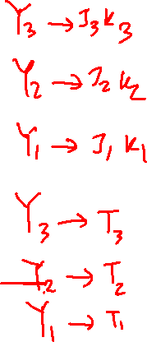
Goal
Implement this state-assigned Table using JK flip-flops

Slide 97
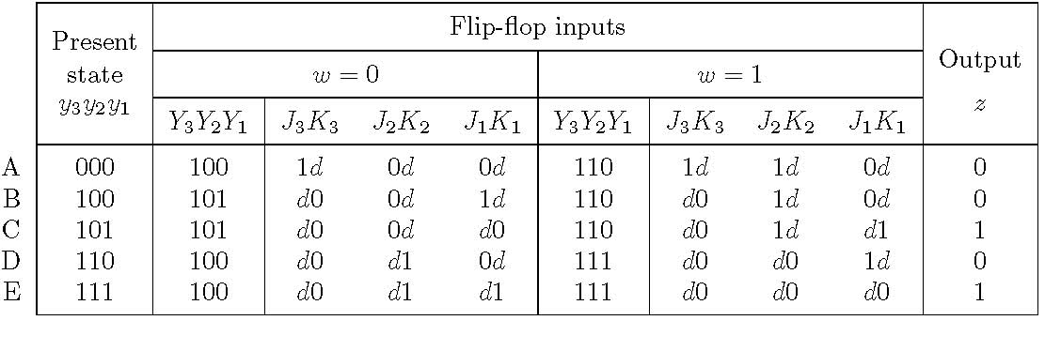
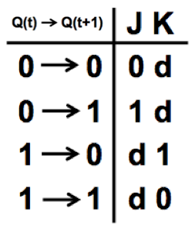
Excitation table with JK flip-flops
[ Figure 6.94 from the textbook ]

Slide 98
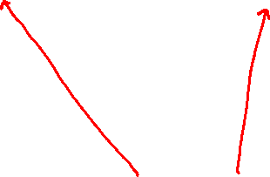


Excitation table with JK flip-flops

Slide 99

Excitation table with JK flip-flops

Slide 100

Excitation table with JK flip-flops

Slide 101
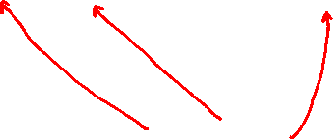
Excitation table with JK flip-flops

Slide 102

Excitation table with JK flip-flops

Slide 103
Excitation table with JK flip-flops

Slide 104
Excitation table with JK flip-flops
And so on...

Slide 105
The Expression for z
z is equal to y₁

Slide 106
The Expression for J₃
J₃ is equal to 1

Slide 107
The Expression for K₃
K₃ is equal to 0

Slide 108
The Expression for J₂
J₂ is equal to w

Slide 109
The Expression for K₂
K₂ is equal to w

Slide 110
The Expression for J₁
J₁ is equal to w y₂ + w y₃ y₂

Slide 111
The Expression for K₁
001
d
K₁ is equal to w y₂ + w y₂ y₁

Slide 112
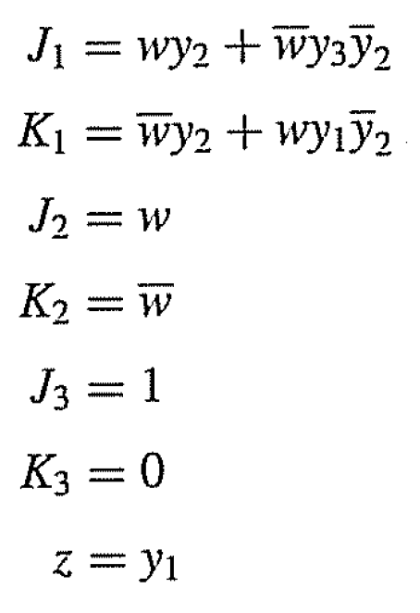
All Logic Expressions

Slide 113

END Slide

